Slide 1
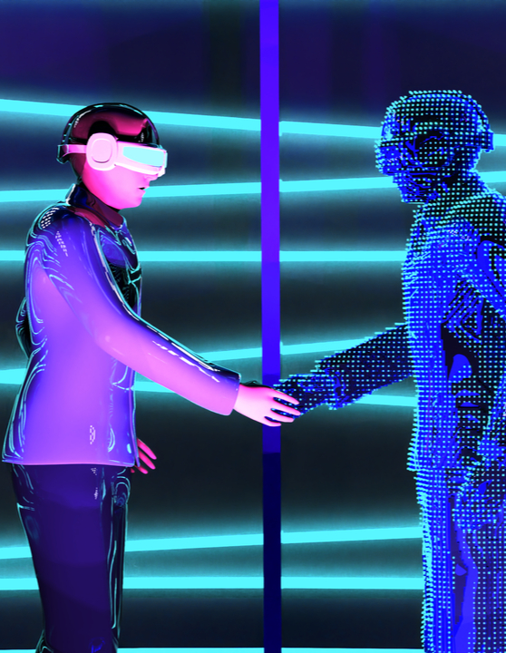
META VERSE
A detailed analysis

Slide 2

AGENDA
OUR UNDERSTANDING
OUR APPROACH
TEAM & BUDGETARY GUIDANCE
GOVERNANCE MODEL

Slide 3

Our Understanding

Slide 4




Our Understanding
BACKGROUND: The Facebook ecosystem continues to grow at a significant rate encompassing hundreds of advertisers amounting to multiple billions of annual Ad spend in the mid-market segment. In order to meet the current challenges and expectations of the customer facing sales teams and executive leadership, the mid-market advertising team is looking for a strategic partner to provide Analytics Services to effectively generate business insights to better service customers, align goals to maximize revenue, and enable strategic differentiation.
Key Areas of Engagement
PILOT SCOPE
FUTURE AREAS OF ENGAGEMENT
Customer Interaction Optimization
Ad-hoc Insight Requirements
Automation
Build data backed approach to “Optimize customer interaction maximizing sales revenue”
Cohort analysis and hypothesis validation for generating insightful actions
Analysis and insights encompassing details on Break Even Points, Granularities, etc.
Ad-hoc analysis for Insight Generation for Internal Stakeholders
Impact analysis of clients using various Facebook products
Analyze areas where competitors may be doing better
Segment level analysis to define strategy
Automation of Data Pipelines
Automation of Alert Mechanisms
Automating Performance Benchmarks At Scale

Slide 5
Infrastructure
Virtualization tools
Virtual world
Chips and processors
Cloud infrastructure
Edge infrastructure
5G & low latency networks
3D design engines
3D modelling and capture
AR development kits
Avatar development
Centralized worlds
Decentralized worlds
Economic Infrastructure
Access/ Interface
Experience
Payments
Crypto exchanges
Crypto wallets
NFT marketplaces
Haptics
VR headsets
Holographics
Smart glasses (AR)
Virtual work
Virtual concerts
Virtual Real estate
Virtual fashion
Gaming

Slide 6
META
WORLD
Chips and processors
Cloud infrastructure
Edge infrastructure
5G & low latency networks
Centralized worlds
Decentralized worlds
Haptics
VR headsets
Holographic
Smart glasses (AR)
3D design engines
3D modelling and capture
AR development kits
Avatar development
Payments
Crypto exchanges
Crypto wallets
NFT marketplaces
Infrastructure
Virtualization Tools
Virtual world
Economic Infrastructure
Access/ Interface
Experience
Virtual Real estate
Gaming
Virtual work
Virtual concerts

Slide 7
Chips and processors
5G and low
Latency networks
Edge infrastructure
Cloud infrastructure

Slide 8





Chips and processors
5G and low
Latency nworks
Edge infrastructure
Cloud infrastructure

Slide 10

Pilot Objective & Execution Phases
PILOT OBJECTIVE: To perform data analysis and build an analytical solution for Optimizing Customer Interaction (CI) to achieve the goal of maximizing sales revenue and optimizing CI goal setting.
Brillio recommends to execute pilot and beyond across three phases as indicated below:
IMMEDIATE SCOPE
PHASE-1
(Week 8)
PHASE-2
(Week 12)
PHASE-3
(Ongoing Managed Services)
Cohort Analysis, Hypothesis Validation, & Insights
Scale up & Productionize pilot
Perform other Ad-hoc analysis
Automation - Data Engineering, Visualization
What-if tool to simulate multiple scenarios
Data Science backed approach to optimize CI and maximize revenue

Slide 11

Our Approach

Slide 12
EXECUTION APPROACH
PHASE-1
PHASE-2
PHASE-3
P1A
P1B
P2
P3
Cohort Analysis & Hypothesis Validation
CI Optimization & Insights
What-if Analysis Tool
Ongoing Managed Services
Transformation of quantitative data from multiple data sources
Conduct interviews/workshops with business stakeholders (sales) to understand the qualitative data aspects
Cohort Analysis to identify segments and traits of customer
Hypothesis formulation and testing to validate the approach & key parameters
Build an optimization solution to define data driven Customer Interaction (CI)
Optimize customer interaction keeping constraints of Number / Frequency / Type / Time of interactions
Build dashboards for easy insights consumption
Build a What-if tool to simulate multiple scenarios:
Impact of change in interaction on revenue on following granularities:
Number
Frequency
Type
Scale up & productionize pilot
Perform other Ad-hoc customer analysis
Automate Data Engineering pipelines, data access and visualization
KEY ACTIVITIES
Phase-1A: Milestone 1
Customer Segmentation
Analysis presentation deck - insights & recommendations
Phase-1B: Milestone 2
Break even points for Number/Type/ Frequency of customer interactions at granularities of vertical, geographical, segment level
Dashboard showcasing key customer interaction insights
Milestone 3:
Ability to test various customer interaction scenarios to identify potential outcomes
Dashboard based What-if Simulator Tool
Self-serve analytical insights
Automation leads to improved team efficiency
OUTCOMES

Slide 13



Our Approach: Phase-1a
Insights’ Discovery, Cohort Analysis, Hypothesis Validation & Recommendations
QUANTITATIVE ANALYSIS
Early adopters
Data Sources *
COHORT ANALYSIS
Value Seekers
CRM Data
Late bloomers
Customer details
Revenue from customer
Products used
Last meeting details, other business data
Define the derived metrics
Calculate right number of cohorts
Perform Cohort Analysis
Identify Cohort level characteristics
High Maintenance
Facebook Products’ Data
Impressions, Cost Per Click, Click Through Rate, Cost per Lead, Customer Acquisition Cost, Ad Spend
Audience Type (firmographics, interests, behaviors)
Ad Effectiveness (Creatives), Ad Placement
Ad Relevance Diagnostics, NPS
Data Preparation & Transformation
HYPOTHESIS VALIDATION
INSIGHTS - FIRST ITERATION
Build and Validate Hypotheses for e.g.:
Higher interaction in e-commerce vertical leads to higher product adoption as compared to other verticals
Increased interaction with Late Bloomers cohort will result in customer moving to Early Adopters cohort over a period of 6 months
In-person and frequent interaction results in higher revenue for High Maintenance Cohort
Sample :
What type of CI for each cohort and break-points
What is inherent “value” of each CI
What pitch topics drive most value
QUALITATIVE ANALYSIS
Conduct interviews & workshops with Personas such as Sales Director, Vertical Lead, Sales Manager, etc.
* - Indicative set of data

Slide 14

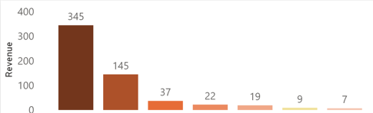

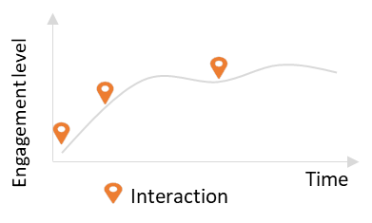
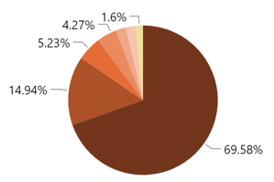
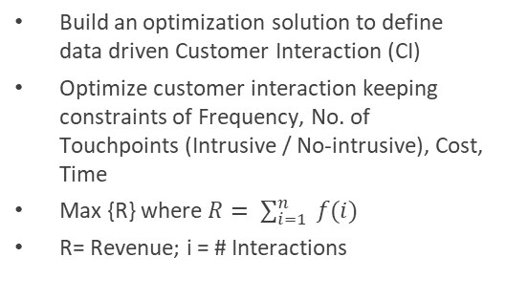
Our Approach: Phase-1b
Data Science backed approach to Optimize CI and maximize revenue
* INPUT
Optimize CI
Insights Consumption
Revenue matrix
Customer level data of product & respective revenue
Key data features - Aggregate quarterly revenue, cohort level rev aggregation
Product usage matrix
Usage level data of each product at customer level
Interaction matrix
Customer & sales manager interaction and corresponding results
Build an optimization solution to define data driven Customer Interaction (CI)
Optimize customer interaction keeping constraints of Frequency, No. of Touchpoints (Intrusive / No-intrusive), Cost, Time
Max {R} where $R= \sum_{i=1}^{n}{ f(i) }$
R= Revenue; i = # Interactions
Dashboards to be leveraged for consumption layer (for sales managers)
Outcome: Key customer interaction insights and recommendations w.r.t. break even points, Type, and channel at granularities of vertical, geography, and segment
Data Preparation & Transformation
Illustrative View
Revenue by Touchpoints
* - Indicative set of data

Slide 15



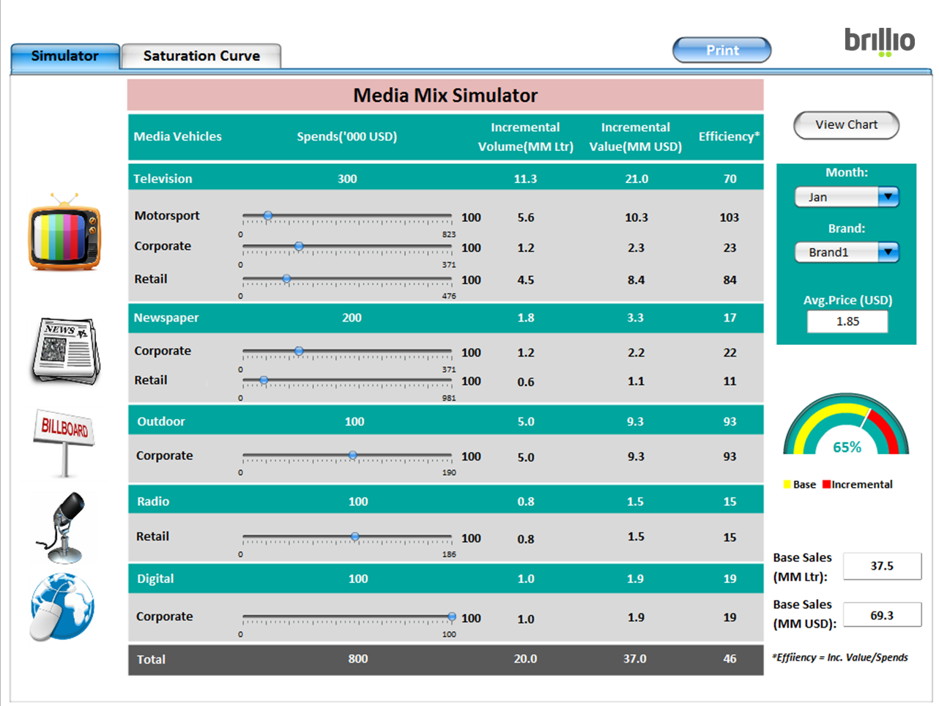
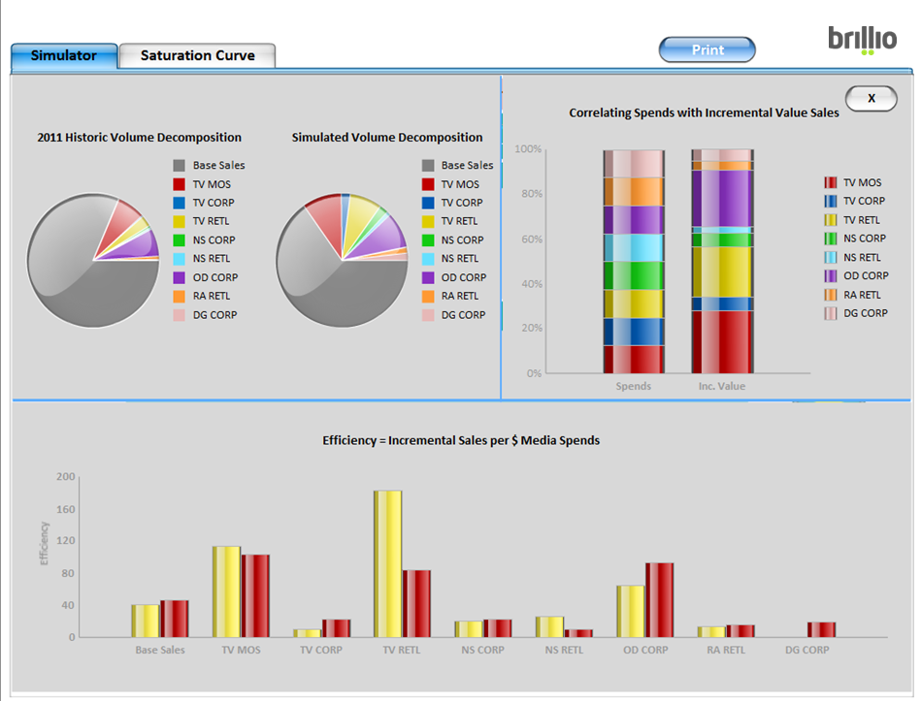
Our Approach: Phase-2
What-if tool to simulate multiple scenarios
INPUT FROM OPTIMIZER
SIMULATION
OUTPUT
Optimize number of customer interactions
Frequency of interactions
Channel Type for interactions
At following granularities:
Verticals
Geography
Segments
What if Simulation tool to identify impact of interaction change on Revenue:
What is the change in revenue if we do less than recommended interactions
What is change in revenue with lesser or different frequency/channel type
Impact in Cohort level outcomes based on change in recommendations
Illustrative View

Slide 16




Our Approach: Phase-3
Ongoing Managed Services
Scale up & Productionize Pilot
Provide managed services to enable scaling up of the pilot engagement at production level
Automation
Automation of data access & visualization to improve team efficiency
Automate data pipelining, alert mechanisms, performance benchmarks at scale
Ad-hoc Analysis
Perform other ad-hoc analysis
Insight generation for point in time questions around CI

Slide 17
Proposed High level Timeline
IMMEDIATE SCOPE
W1 |  | W2 |  | W3 |  | W4 | W5 | W6 | W7 | W8 | W9 | W10 | W11 | W12 | … | WNN
PHASE-1
Transformation of data from multiple data sources
1
2
3
PHASE-1A
Milestone-1
Milestone-2
Milestone-3
Conduct interviews with business stakeholders to understand the qualitative data aspects
Cohort Analysis to identify traits of input data
Hypothesis building & testing to validate the approach
PHASE-1B
Build an optimization solution to define data driven Customer Interaction (CI)
Dashboard & Insights
Dashboard & Insights
PHASE-2
What-if analysis tool to simulate multiple scenarios of CI to Revenue relationship
PHASE-3
Ongoing Managed Services

Slide 18

Team Structure & Budgetary Guidance

Slide 19
Assumptions & Dependencies
Scope Related:
Limit the optimizer/regression solution build to two iterations
Recommendation dashboard with max. 3 views and 10 KPIs
The pilot execution is scoped as per the time mentioned in the phases
Focus customer verticals will be E-commerce, Travel & Telecom
Four Cohorts to be analyzed - Early adopters, Value Seekers, Late Bloomers and High Maintenance
Brillio will leverage BI tool to build the What-if simulator
Any change in scope and assumptions will affect the estimated effort
Work Item Related:
Relevant data from multiple sources like CRM and Facebook products would be shared by Facebook for analysis
Quality of data is assumed to be good and no data quality improvement activity at source is considered as part of this engagement
Facebook SPOC will ensure that required clearance access to data exists in place before the engagement start date
Facebook to provide all relevant documentation already done as part of the project (if any)
Facebook will provide the appropriate accesses to the network, systems, data, and relevant documentation related to project and policies latest before the start of the project
The overall timeline for the completion of Pilot project is dependent on the availability of Facebook’s key stakeholders and their participation as per the schedule agreed prior to the kick-off of this engagement
Miscellaneous:
Brillio team will highlight the roadblocks during daily/weekly/ad-hoc governance meetings and Facebook is expected to take cognizance of those and ensure these are resolved
Brillio would leverage necessary tools from Facebook IT ecosystem in collaboration with Brillio accelerators to deliver maximum benefits to Facebook
If either party anticipates any material changes to the actual scope of work stated herein, or if Facebook requests Brillio to perform any out-of-scope services which significantly affects the agreed upon timelines and fees, then such change(s) shall be mutually agreed and made in writing and prior to such work being performed by Brillio
All offshore activities would be performed from Brillio India offices
All travel, accommodation, allowances and other expenses incurred for travel to client’s location will be charged at actuals capped at 10%
Software, licenses, third party tools, Infra and other setup costs are not included in the pricing

Slide 20
LET US CREATE SOMETHING AMAZING!
THANK YOU
TOGETHER.

